Slide 1
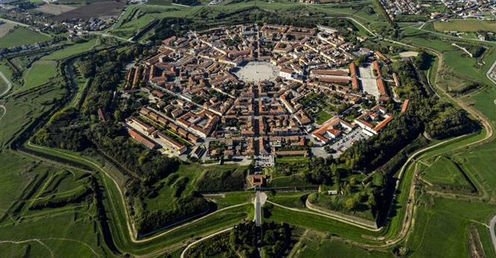
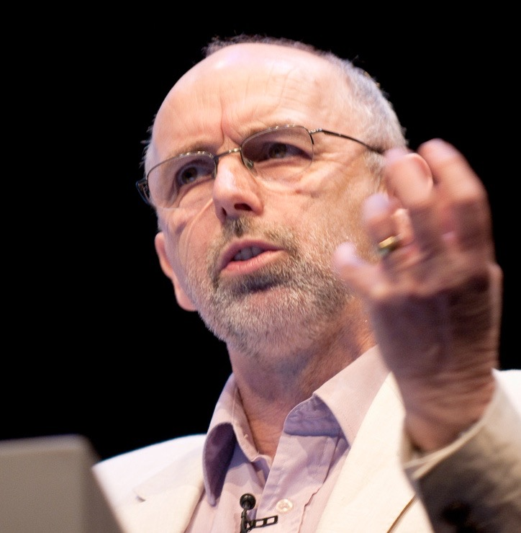
3rd Annual BIBFRAME Workshop in Europe
Stockholm
17th September 2019
The Relevance of BIBFRAME Beyond our Walls
Richard Wallis
Evangelist and Founder
Data Liberate
richard.wallis@dataliberate.com
@rjw

Slide 2
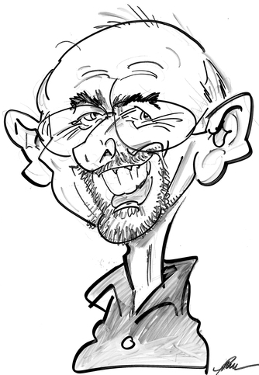
Independent Consultant, Evangelist & Founder
40+ Years - Computing
29+ Years – Cultural Heritage technology
18+ Years – Semantic Web & Linked Data
W3C Community Groups:
Bibframe2Schema (Chair) – Standardised conversion path(s)
Schema Bib Extend (Chair) - Bibliographic data
Schema Architypes (Chair) - Archives
Financial Industry Business Ontology – Financial schema.org
Tourism Structured Web Data (Co-Chair)
Schema Course Extension
Schema IoT Community
Educational & Occupational Credentials in Schema.org
Works With:
Google – Schema.org vocabulary, site, extensions. documentation and community
OCLC – Global library cooperative
FIBO – Financial Industry Business Ontology Group
Various Clients – Implementing/understanding Schema.org:
British Library — Stanford University — Europeana — NLB Singapore
richard.wallis@dataliberate.com — @rjw

Slide 3
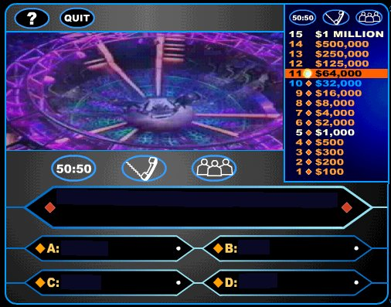
2018 Workshop
Who Wants to be a Linked Data Library
What are my Library Linked Data Options?
BIBFRAME 2.0
Schema.org
Linky MARC
Do nothing
Notes:
For libraries with Linked Data ambitions the $64,000 question is which option do I take?
BIBFRAME 2.0
Schema.org
Linky MARC
Do nothing
Let’s review the options

Slide 4
Inside the walls

Slide 5
BIBFRAME is a Good Thing!
(2.0)
The Only Linked Data vocabulary for bib data ?
Best Linked Data vocabulary for bib data ?
Universally loved by librarians ?
Powering lots of systems ?
Satisfies most bibliographic LD use cases ?
Recognised / supported by systems developers ?
A de facto international standard ?
Supported by a wide consensus ?
No
Probably not
No!
No
Yes
By some
Becoming so
Yes -ish

Slide 6
BIBFRAME (2.0) is a Good Thing!
Most System Developers would admit as a minimum:
Must be able to import BIBFRAME
Must be able to export BIBFRAME
Must be able to handle links in MARC
MARC to BIBFRAME Conversion Specs
MARC to BIBFRAME Conversion Scripts
Enables entification
A route from MARC records to Linked Data
The most important step on the road to Linked Data
(Regardless of vocabulary)

Slide 7
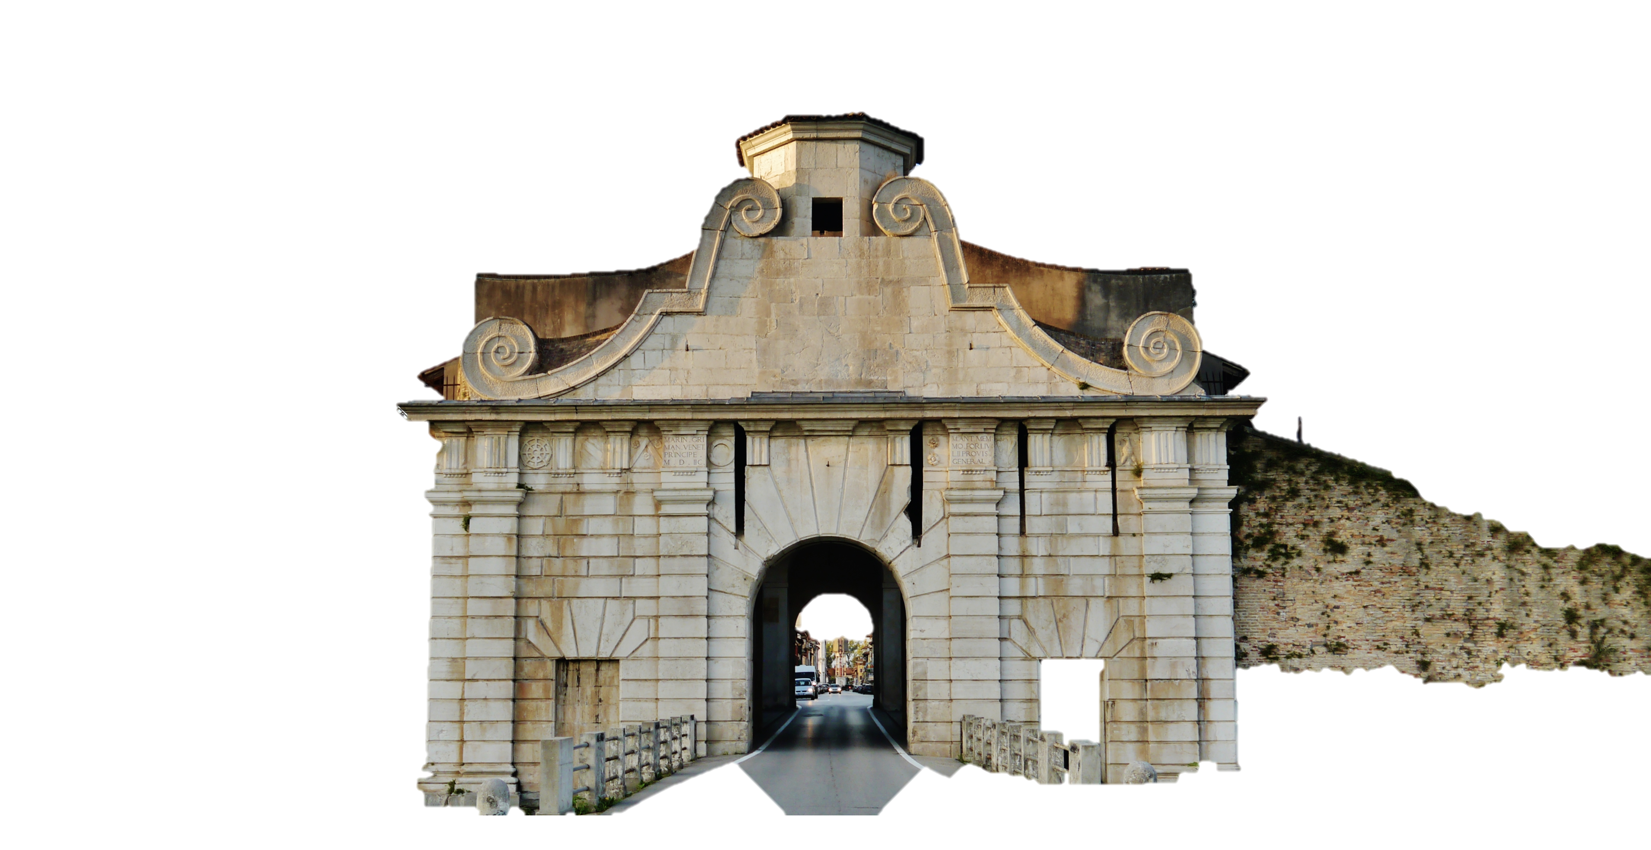
The Route In
The MARC Gateway
The MARC Gateway
Converts Enter YE Here
Most Implementers will start with a MARC based dataset to convert
Temporary Exit ?

Slide 8
BIBFRAME/RDA/MARC - Baggage
Driven by MARC conversion needs
bflc:name00MarcKey
bflc:title40MatchKey
The Winstance problem
Most record conversions currently result in a linked pair of entities
Work & Instance
For the benefit gained might as well just have a single Winstance!
When is a Work a Work or a Hub/SuperWork or an Instance of one?

Slide 9
Working Inside the walls

Slide 10
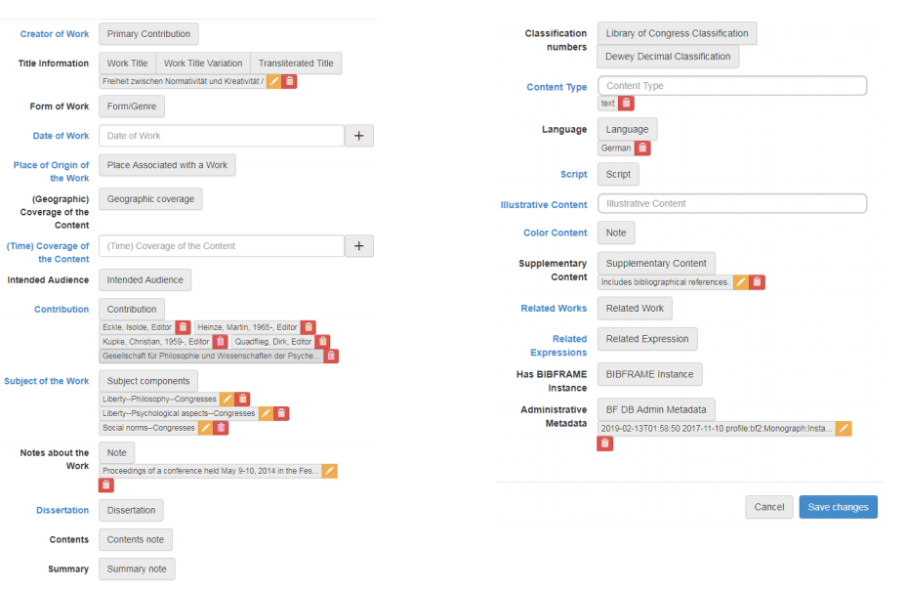
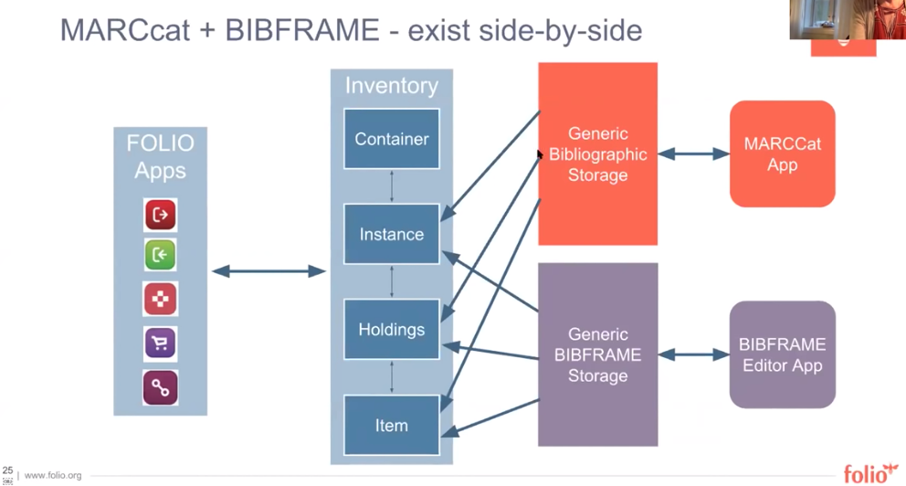
Entity Management
LC BIBFRAME Editor
SINOPIA Editor
Alma BIBFRAME View
Innovative Interfaces Inspire
Folio (future)
OCLC Project Passage
(Entity management & reconciliation)

Slide 11
Outside the walls

Slide 12
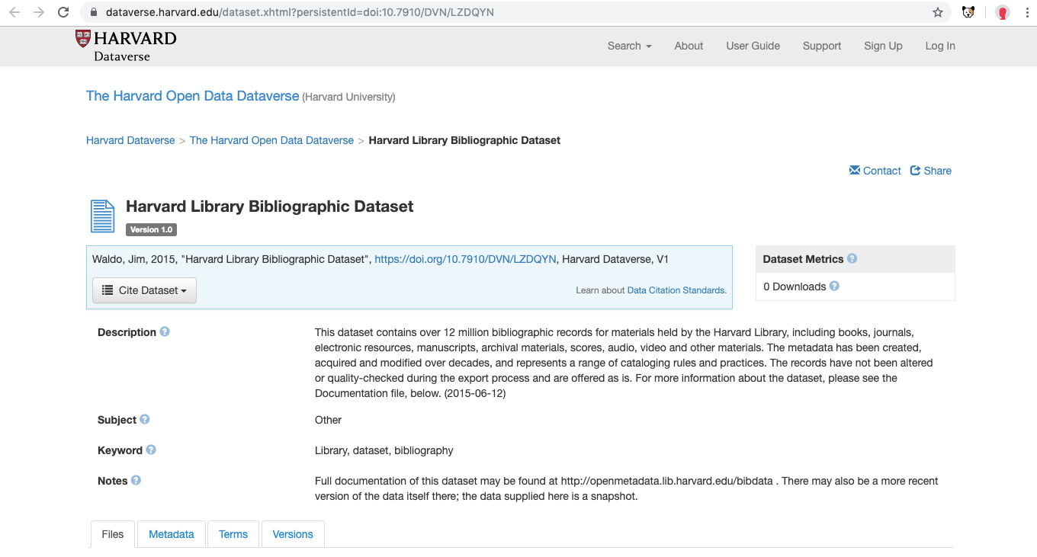
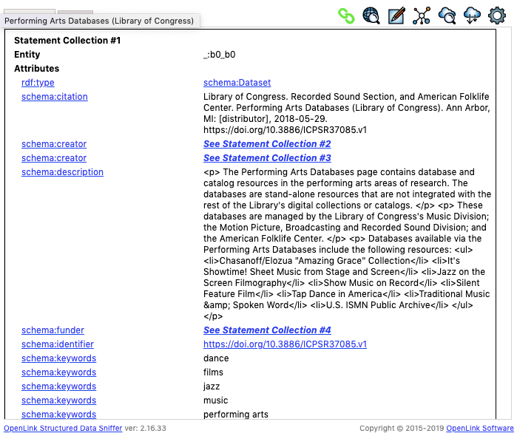
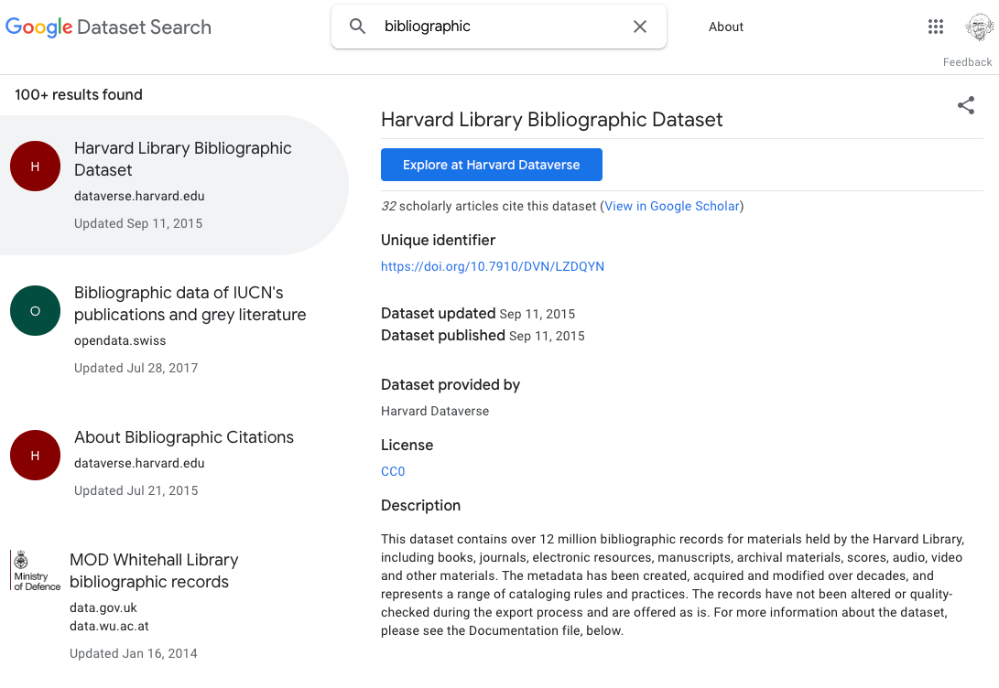
Structured Data On The Web Today

Slide 13
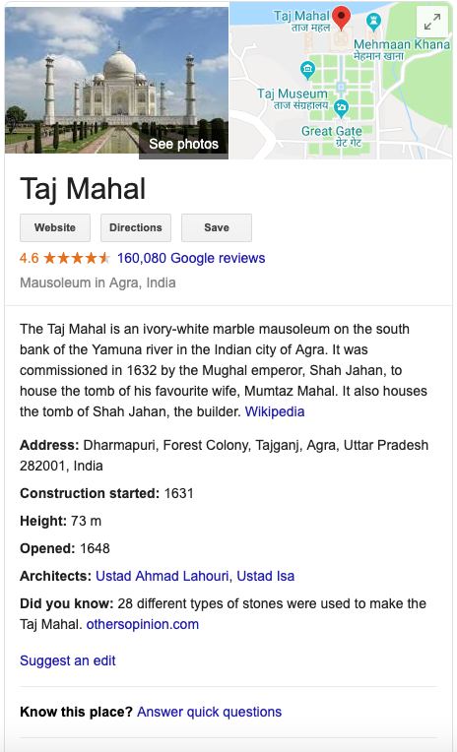
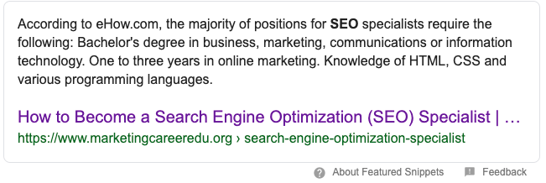
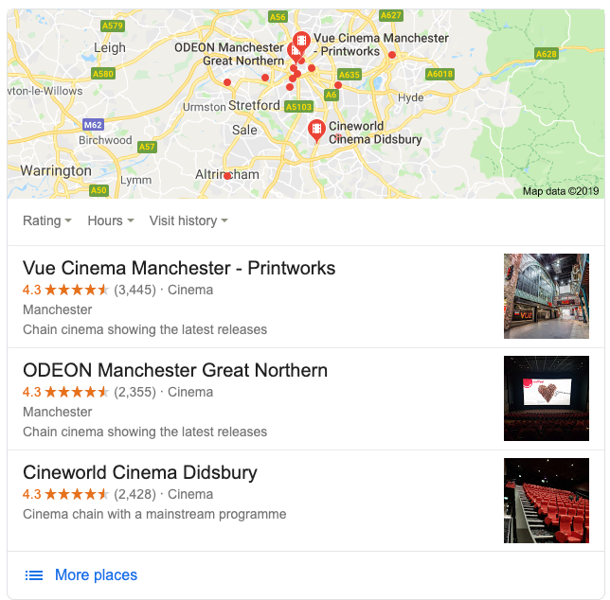
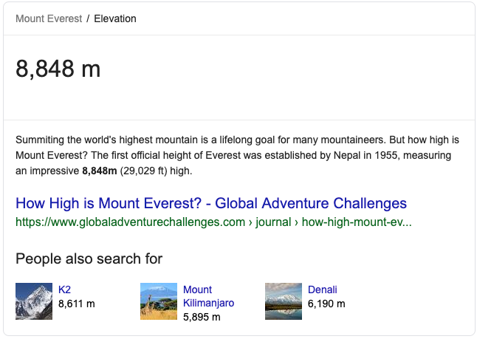
Knowledge Graph

Slide 14
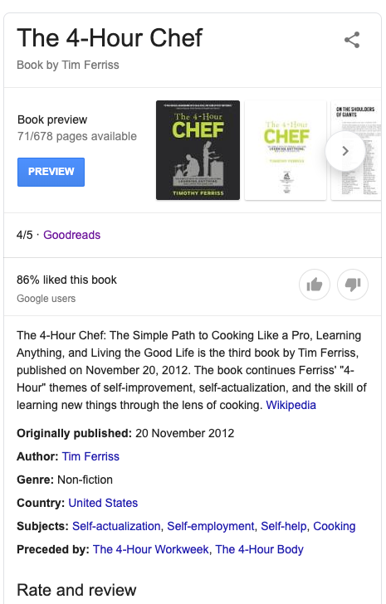
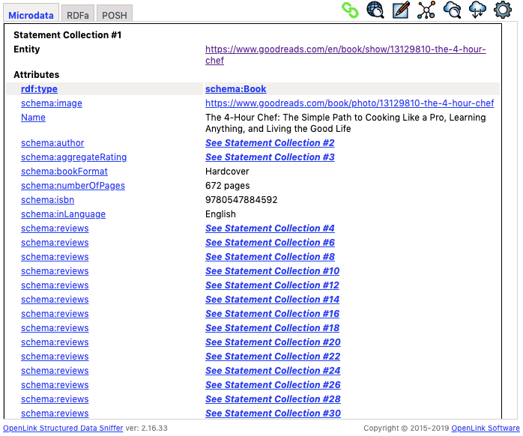
Knowledge Graph

Slide 15
Knowledge Graph?
How do I get my stuff into it?
bf:Work
Tale of Two Cities
bf:Instance
Tale of Two Cities
bf:Place
Paris
bf:Person
Charles Dickens
A basic graph of entities (BIBFRAME)

Slide 16
How
Relevant
is
BIBFRAME
Beyond our Walls
?

Slide 17
BIBFRAME
is
Not
Relevant
*
Beyond our Walls
*Of Cultural heritage

Slide 18
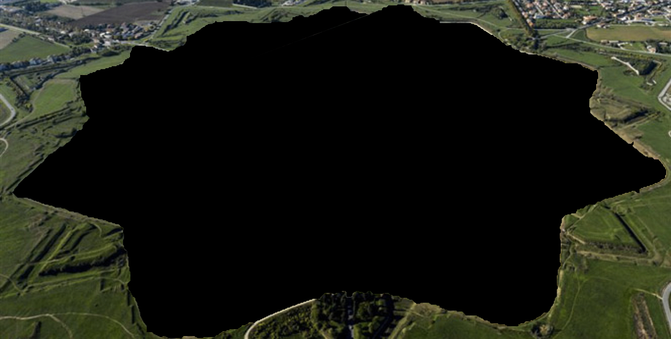
Where are our
users?
… mostly out of our reach …

Slide 19
How to reach those users?
bf:Work
Tale of Two Cities
bf:Instance
Tale of Two Cities
bf:Place
Paris
bf:Person
Charles Dickens

Slide 20
How to reach those users?
bf:Work
schema:CreativeWork
Tale of Two Cities
bf:instance
schema:CreativeWork
schema:Product
Tale of
Two Cities
bf:Place
schema:Place
Paris
bf:Person
schema:Person
Charles Dickens
Add Schema.org

Slide 21
Knowledge Graph
bf:Work
schema:CreativeWork
Tale of Two Cities
bf:instance
schema:CreativeWork
schema:Product
Tale of
Two Cities
bf:Place
schema:Place
Paris
bf:Person
schema:Person
Charles Dickens
Add context with Schema.org

Slide 22
Knowledge Graph
Improving by Reconciliation
Automatic discovery of new entities using graph reconciliation
Inventors: Oksana Yakhnenko and Norases Vesdapunt
Assignee: GOOGLE LLC
US Patent: 10,331,706
Granted: June 25, 2019
Filed: October 4, 2017

Slide 23
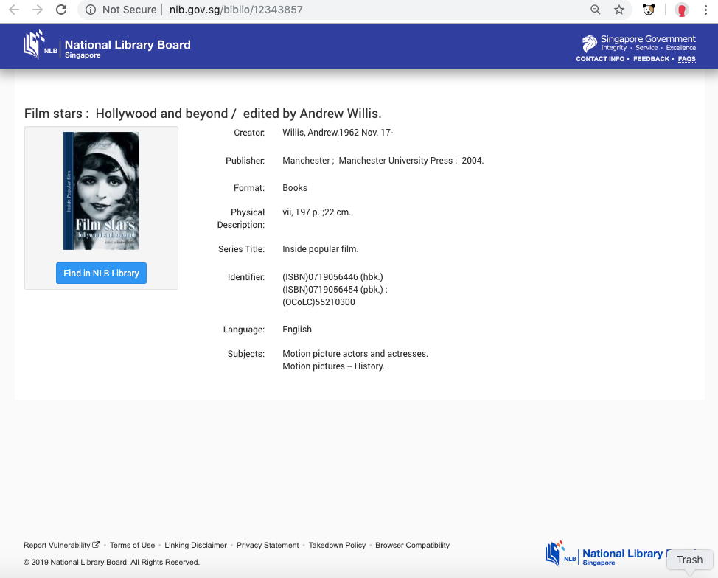
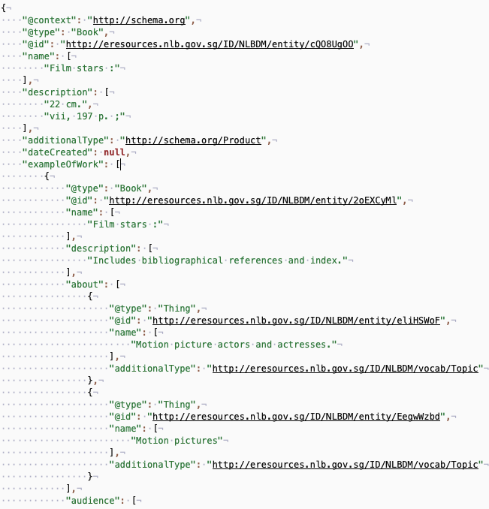
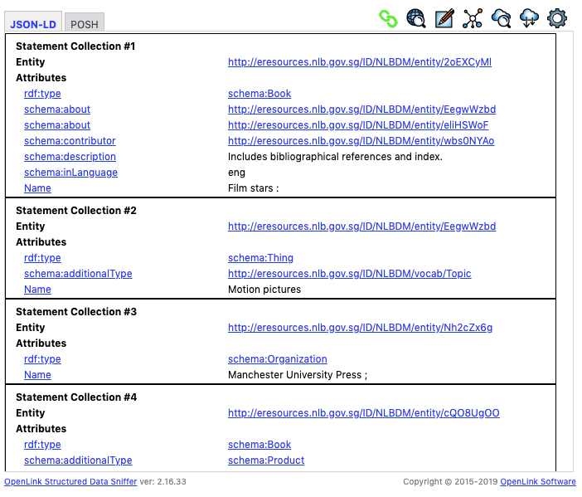
Structured Data On The Web Today

Slide 24
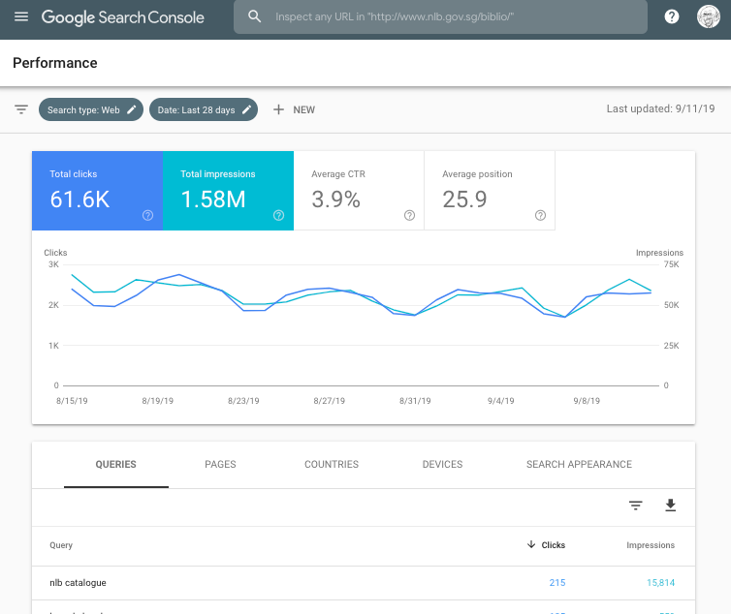
Structured Data On The Web Today

Slide 25
Structured Data On The Web Today
NLB Singapore Schematic
Sitemap
BIBFRAME
Schema.org
Googlebot
Spydus Library
System
MARC to NLBDM Conversion
RDF TripleStore
Static Page Creation
Static Site

Slide 26
Structured Bibliographic Data On The Web Today
Wot do we need to do about it?!

Slide 27
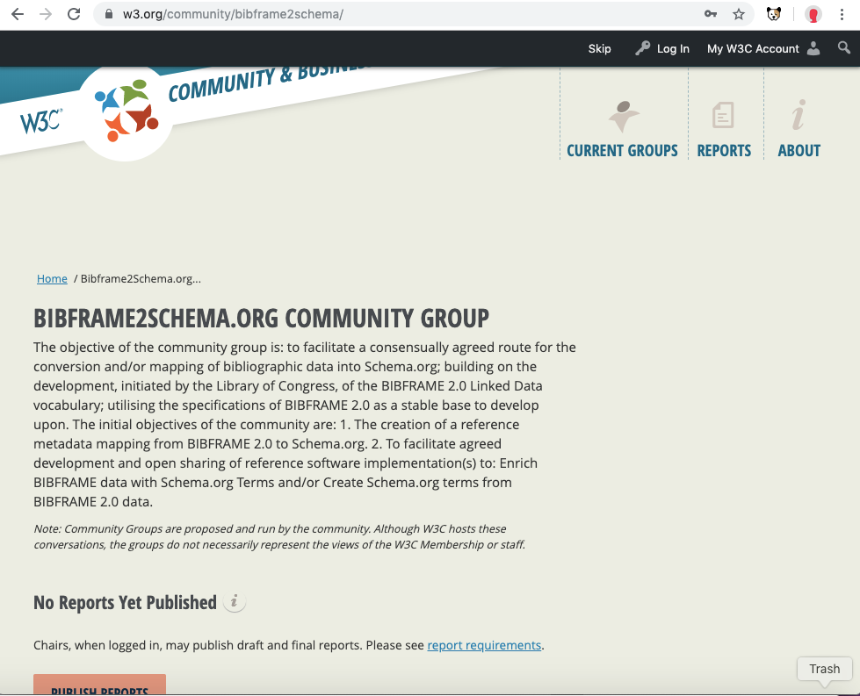
Embark on the Final Mile Together
Keep refining BIBFRAME
Solve the Work Reconciliation problem
In a consistent repeatable way
Promote reconciliation services (OCLC / LC ?)
BIBFRAME to Schema.org enrichment / mapping
BIBFRAME2Schema.org
Build working examples
Schema.org is complementary not competitive!
It will get our stuff indexed!
Challenges:
Mapping to correct type
What is a Book!?
No Agent type in SDO
Need examples to criticise

Slide 28
The
Relevance
of
BIBFRAME
Beyond our Walls

Slide 29
BIBFRAME
‘s
Lack
of
Relevance
Beyond our Walls

Slide 30
3rd Annual BIBFRAME Workshop in Europe
Stockholm
17th September 2019
The
Relevance
of
BIBFRAME
Beyond our Walls
Richard Wallis
Evangelist and Founder
Data Liberate
richard.wallis@dataliberate.com
@rjw

